Slide 1

Driving Forward: Anticipating Car Prices

Slide 2
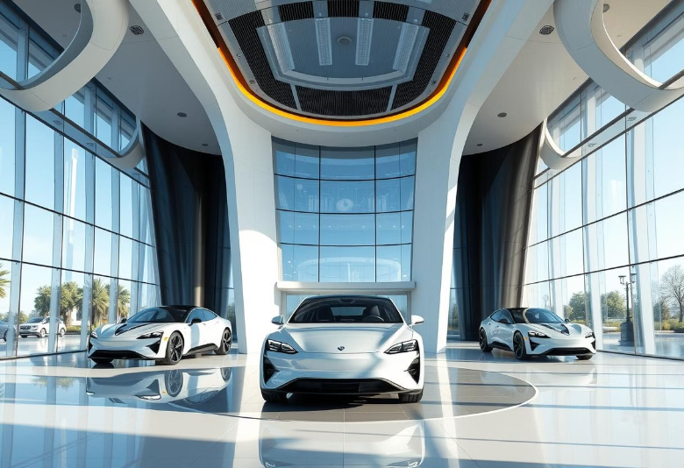
Let's Solve This:
A car company expands into the USA market, understanding and predicting car prices is essential for competitive pricing and market positioning. Car prices are influenced by multiple factors, including vehicle features, technical specifications, brand reputation, and market demand. Without an accurate pricing strategy, the company risks overpricing, leading to lower sales, or underpricing, reducing profitability. To address this challenge, the company aims to develop a data-driven car price prediction model that analyzes these key factors. By leveraging machine learning and historical market data, the model will help estimate optimal car prices, ensuring competitiveness and maximizing revenue potential in the US automotive market.

Slide 3





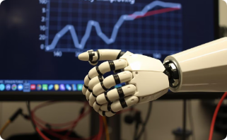

Topic: Business
Data Collection & Preprocessing
Exploratory Data Analysis (EDA)
Feature Engineering
Model Selection & Benchmarking
Crafting relevant features for the model.
Gathering and preparing the data.
Uncovering patterns and insights.
Choosing the best model for the job.
Hyperparameter Tuning
Improvement of Model Performance
Deployment
Optimizing model parameters.
Putting the model into action.
Enhancing model accuracy.

Slide 4
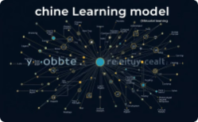



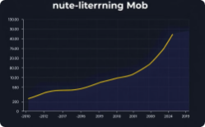




PROPOSED SOLUTION:
Data-Driven & Objective
Market-Aware
Scalable & Adaptive
Automated & Efficient
Uses data to provide neutral insights.
Considers market factors for pricing.
Adjusts to changing data and scales efficiently.
Streamlines pricing with automation.
Increased Sales & Market Share
Optimized Profit Margins
Enhanced Customer Trust
Strategic Business Decision-Making
Drives revenue and market presence.
Maximizes profitability through pricing.
Builds confidence through fair pricing.
Informs key business strategies.
Competitive Advantage
Secures a leading edge in the market.

Slide 5

Tools, Technologies and Frameworks
Machine Learning
Linear Regression
Lasso (L1)
Ridge (L2)
SVM
Decision Tree
Random Forest
Ensemble Methods
Data Analysis
Python
Pandas
Numpy
Matplotlib
Seaborn
Model Deployment
Streamlit
Libraries
Scikit-learn
XGBoost
LightGBM

Slide 6
Model Evaluation & Hyperparameter Tuning
Model Evaluation:
Hyperparameter Tuning:
Linear Regression
Decision Tree (max\_depth, min\_samples\_split, min\_samples\_leaf)
Decision Tree
Random Forest
Random Forest (n\_estimators, max\_depth, min\_samples\_split)
L1 (Lasso)
L2 (Ridge)
SVM (C, Kernel, Gamma)
SVM
Ensemble Methods (learning\_rate, n\_estimators, max\_depth, subsample)
Ensemble Methods

Slide 7
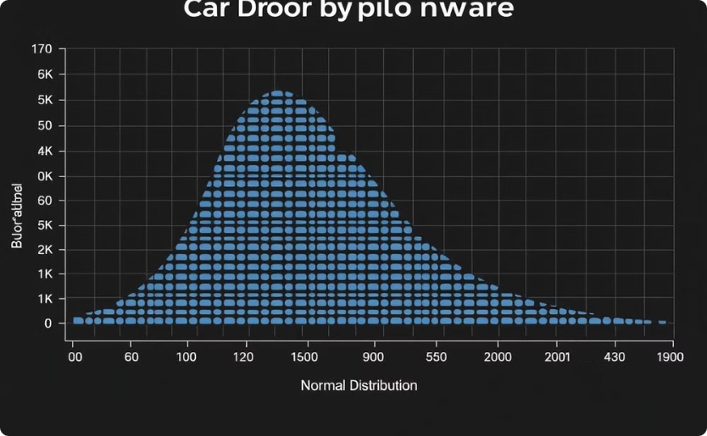
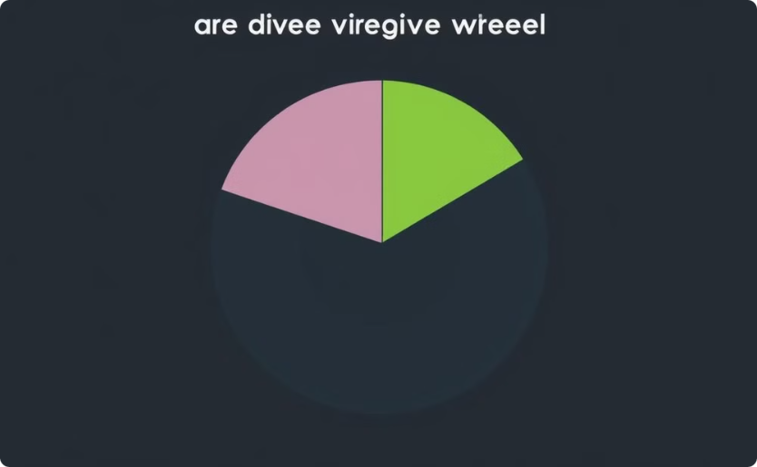
Data Visualization
Distribution of Door Number
Distribution of Drive Wheel
Visualizing the frequency of different door numbers in our dataset.
Exploring the prevalence of various drive wheel configurations.

Slide 8
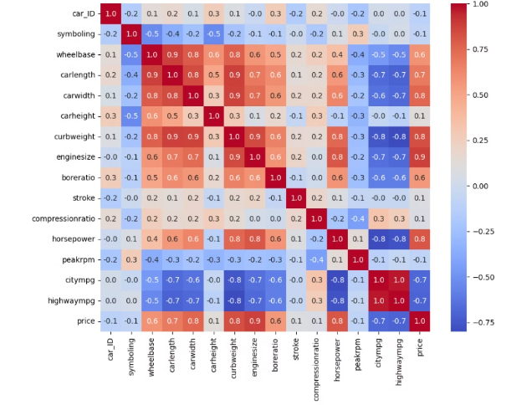
Heatmap
The heatmap visually represents the correlation between different features in the dataset. This helps to identify the strength and direction of the relationships between variables.

Slide 9
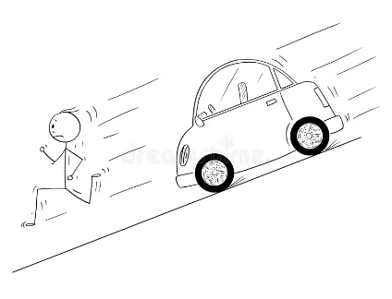







Exploratory Data Analysis (EDA)
Engine Size and Price
Fuel Efficiency
Horsepower and City Mileage
Drive wheel Configuration
Weight and Acceleration
Car Body and Price
Engine Type and Price

Slide 10

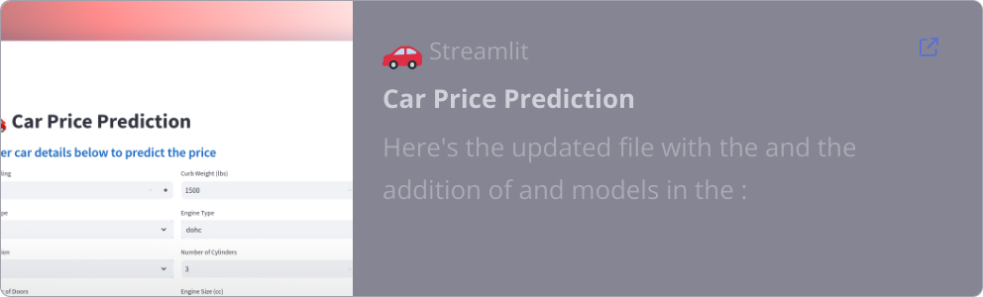
Deployment
The car price prediction model is deployed via Streamlit Cloud, making it readily accessible for users. This deployment enables the car company to leverage the model effectively for pricing decisions and market analysis.
Link to Application:

